Slide 1
Software for social identity mapping
Samuel Barnes

Slide 2
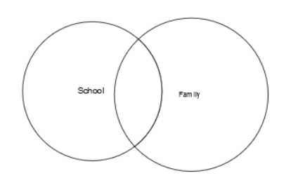
Social identities
How individual attitudes are constructed through conformity, social perception, and prejudice
The attitude forming process develops these “social identities”

Slide 3
The goal
Develop a methodology for representing and collecting social identities for
Comparison within individuals
Comparison between individuals

Slide 4
Platform
Need a visual representation of these social identities
Using web tools, we can develop a website for users to complete the survey
JavaScript is a important component in the mapping process
Fabric library is good for mapping circles on a canvas
Paper is good for mapping circles and their relationships

Slide 5
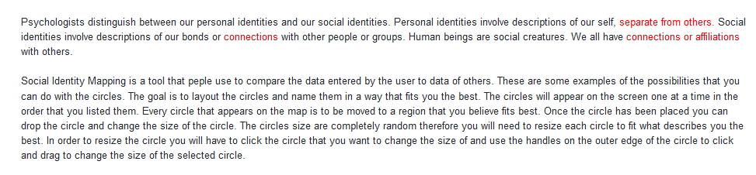
Introduction
The first step is to inform the user about social identity mapping without misleading them or persuading them in a particular direction
It is important that the user should be informed about the confidentiality of the process and their right to abort at any time
Give the user a few examples without labeling the identities to show what they can do

Slide 6
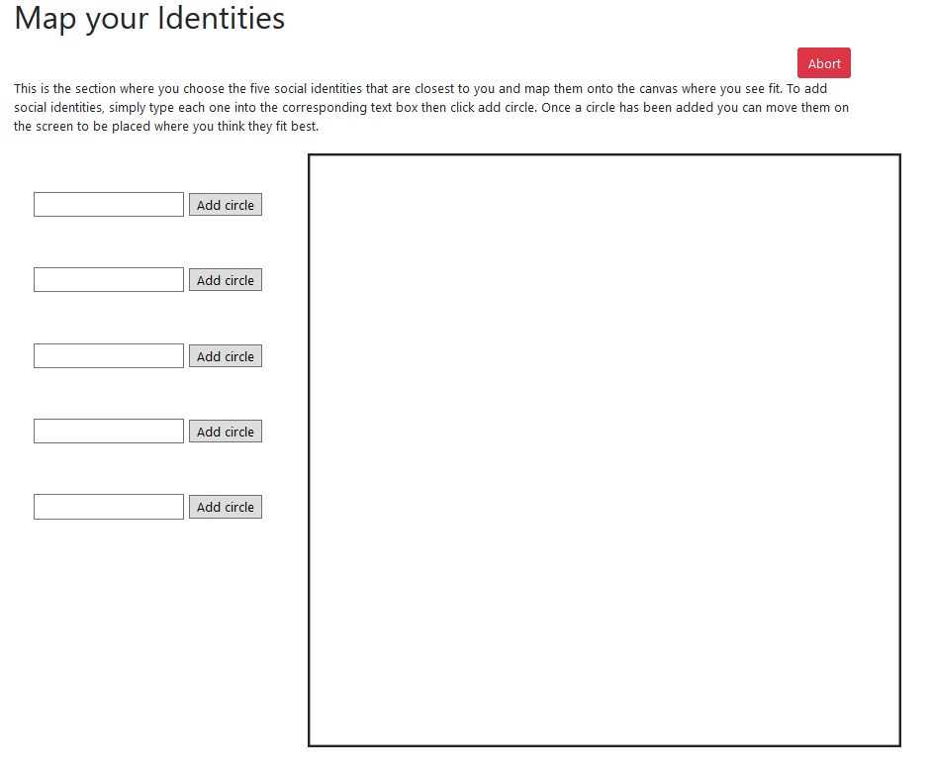
Initial mapping
The user is prompted with clear and thorough instructions
Given a blank canvas with five forms to the left of the canvas
Once a user submits an identity, it is randomly placed on the canvas with a random circle size
The user can rearrange and relabel their identities to where they see fits best

Slide 7
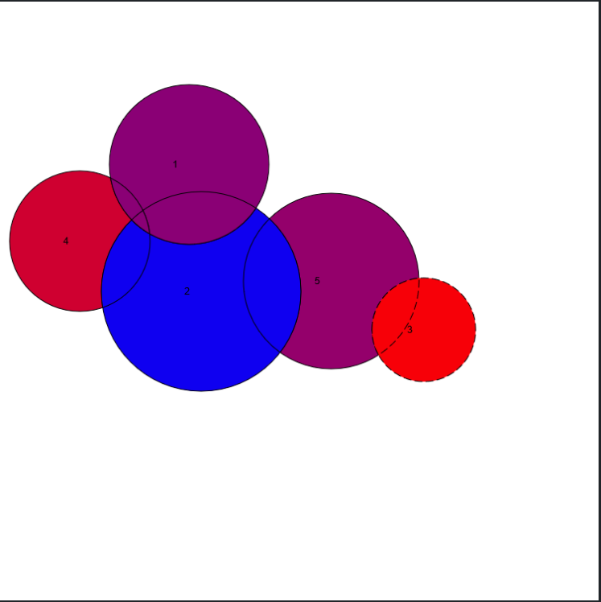
Extended mapping
The user is given the same blank canvas as before except now they can color their circles and intersections
Color represents their feeling toward a particular identity
Red meaning a negative feeling and blue meaning a positive feeling
This second mapping allows for further interpretation of the users choice of identities

Slide 8
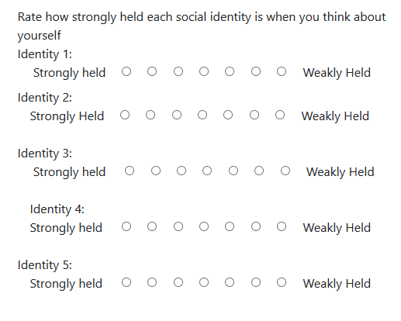
Survey on mapping process
User is given the opportunity to explain their reasoning behind each specific identity they used
Allows the collection of data to be more accurate
Allows user to elaborate on their choices

Slide 9
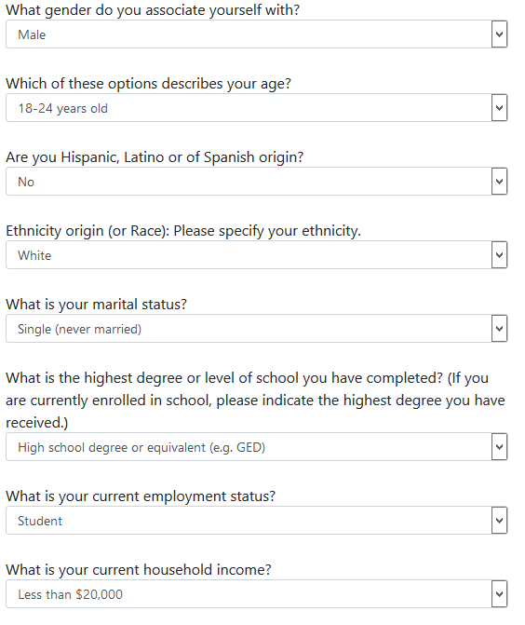
demographics
Important demographics is done after user has finished mapping and survey
Doesn’t prime the user before mapping
Allows the collection of data to be grouped for further comparison
Can create links between certain users and unlink other users

Slide 10
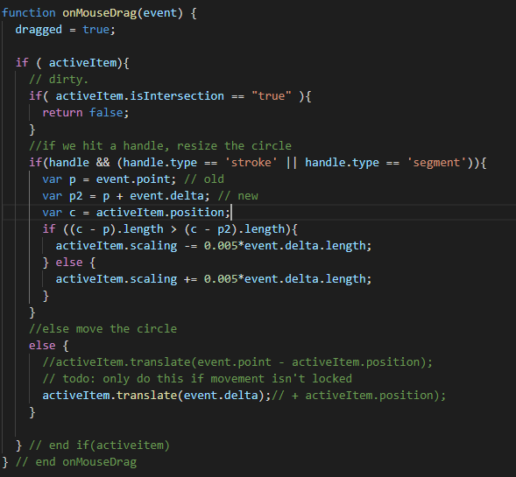
Software for mapping
Need to account for all possible mapping of circles
Different possible intersections, coloring of all intersections
Paper.js library allows for manipulation of circles easily
Bootstrap is easy to use stylesheet for the entire website

Slide 11
Further implementation
Developing a backend for data to be used throughout the site
Autofill forms on second mapping to be what user entered on initial mapping
Autofill survey page to display identities rather than identity 1, 2, etc.
Storing all user data into a database for collection
Better layering techniques of mapping phase

